Slide 1
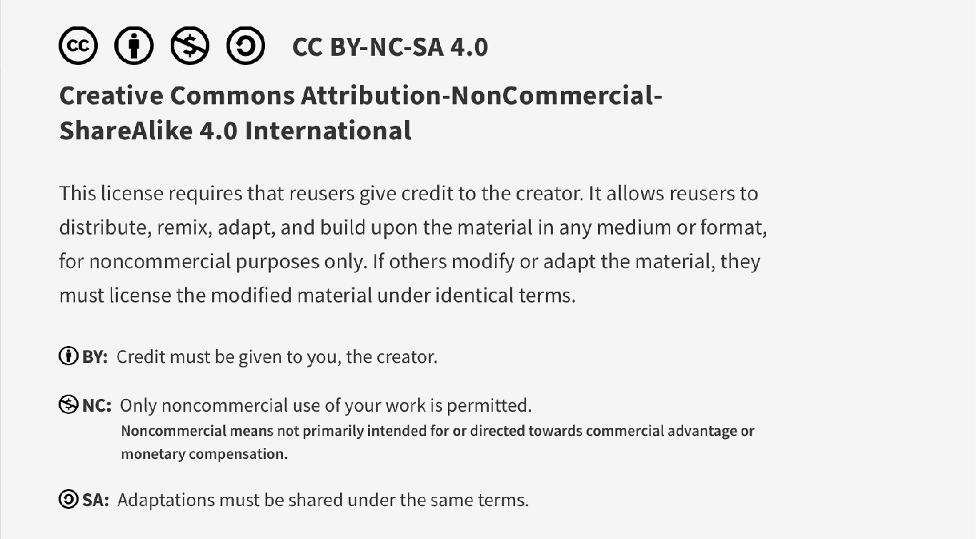
This work is licensed under CC BY-NC-SA 4.0. To view a copy of this license, visit: https://creativecommons.org/licenses/by-nc-sa/4.0/

Slide 2
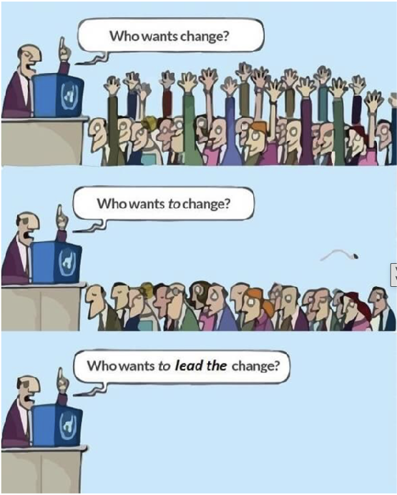
Introduction to Quality Improvement 1 Pre-session material
Lucie Filteau, MD, FRCPC
PGY 2-4 AHD
QPS Lecture series
Lute, 2012

Slide 3
What is Quality in Healthcare?
Quality health care means doing the right thing at the right time in the right way for the right person and having the best possible outcome.
Agency for Healthcare Research and Quality

Slide 4


Do We Have a Quality Problem?
Comparison of healthcare quality between universal healthcare countries:
Canada fared the worst (or amongst the worst) on MANY of the quality measures despite very high per capita spending!

Slide 5
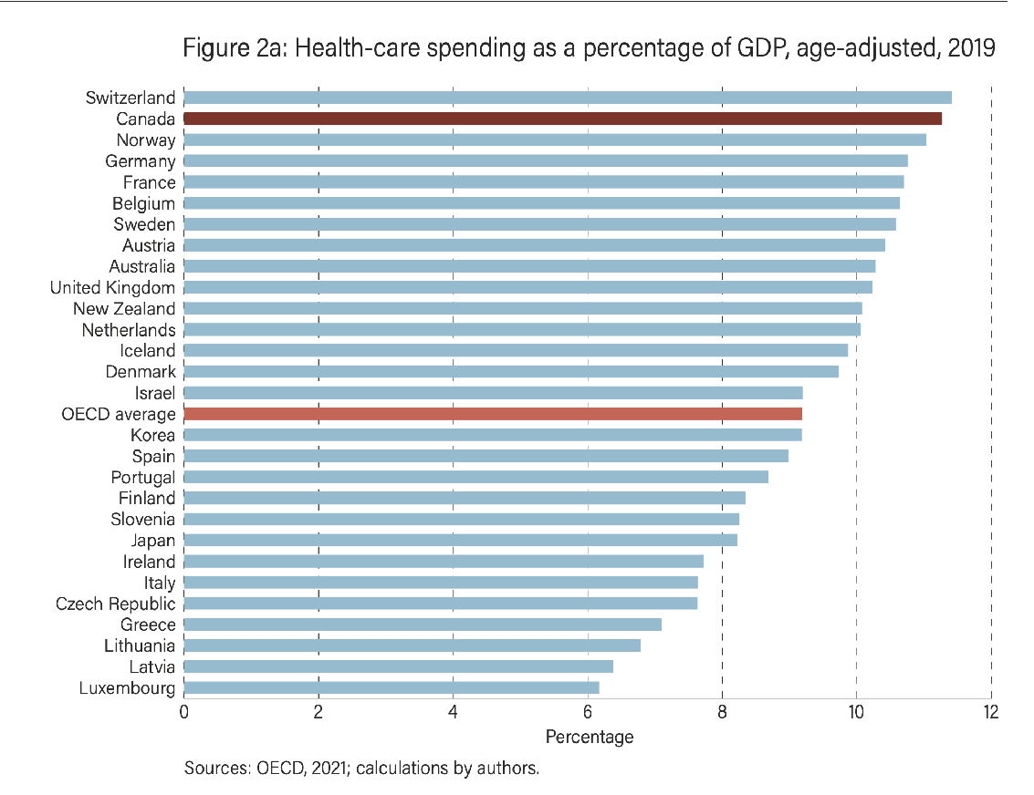
What We Spend
Compared to all other countries (28) with universal healthcare:
Canada ranked 2/28 for age-adjusted healthcare spending as % of GDP
Canada ranked 8/28 for age-adjusted healthcare spending per capita
= WE SPEND LOTS OF MONEY FOR HEALTHCARE!
https://www.fraserinstitute.org/sites/default/files/comparing-performance-universal-health-care-countries-2021.pdf

Slide 6
What We Get (rankings c/w other countries)
POOR access to resources (2019/20 data, note denominator varies)
26/28 for availability of physicians (per capita)
14/28 for availability of nurses
25/26 for # acute hospital beds per capita
24/28 for # psychiatric beds per capita
22/26 for # CT scanners per million
21/24 for # MRI units per million
9/10 for ability to get same day appointment when sick
8/10 for ease to find care after hours
10/10 for waiting > 4 weeks for appointment with specialist
10/10 for waiting > 4 months for elective surgery
https://www.fraserinstitute.org/sites/default/files/comparing-performance-universal-health-care-countries-2021.pdf

Slide 7
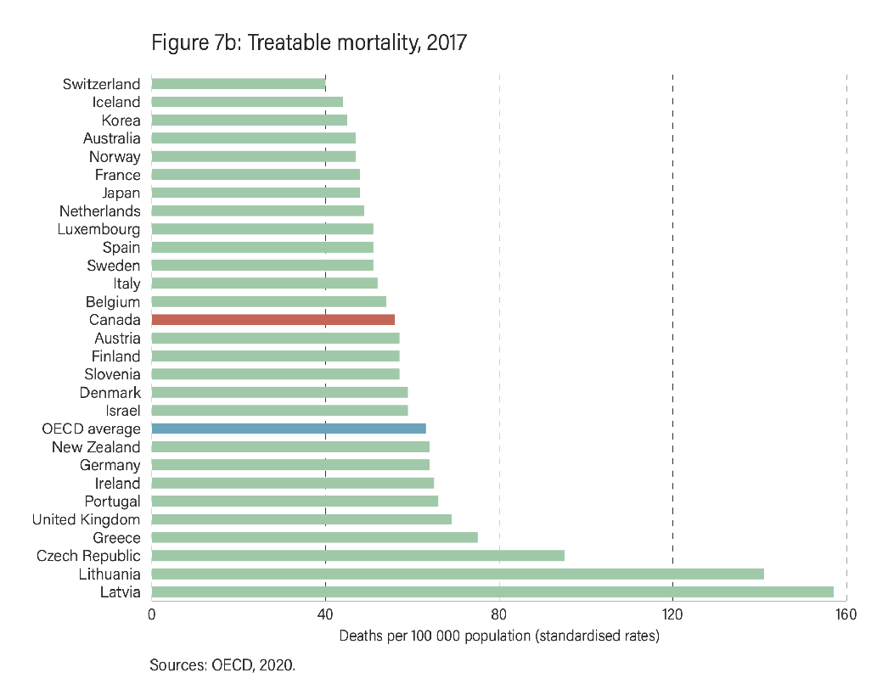
Treatable mortality: 14/28 countries (2017)
EXAMPLES:
Sepsis/cellulitis/meningitis
Breast/uterine/cervical/colorectal CA
Diabetes/thyroid/adrenal disorders
URTI/pneumonia/asthma/pulm edema
AAA/HTN/CAD/VTE
Appendicitis/ulcers/hernia/cholecystitis
Renal failure/obstructive uropathy
Pregnancy/childbirth
Surgical/medical misadventures
Medication adverse events
Medical device adverse events
https://www.fraserinstitute.org/sites/default/files/comparing-performance-universal-health-care-countries-2021.pdf

Slide 8
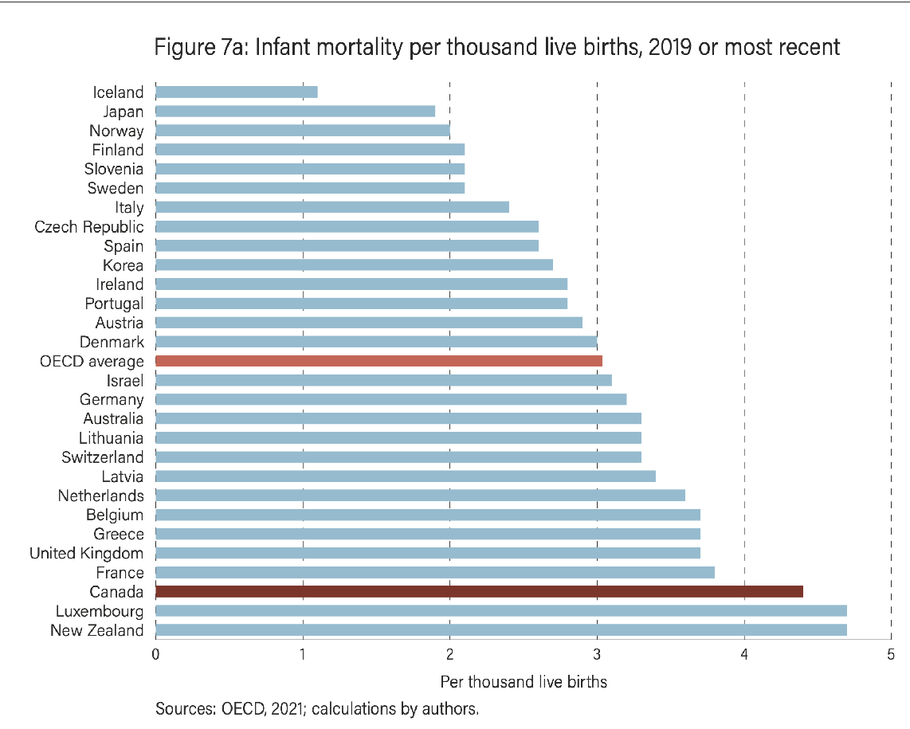
Infant mortality
Ranked 26/28 for infant mortality
Ranked 20/28 for perinatal mortality
https://www.fraserinstitute.org/sites/default/files/comparing-performance-universal-health-care-countries-2021.pdf

Slide 9
Some Measures are Bit Better...(2019)
Postop wound dehiscence: 7/28
Hip fracture surgery within 48 hrs: 6/22
Postop sepsis (abd sx): 2/28
Acute MI (admitted patients) 30 day mortality: 9/27
5-year survival
Breast cancer 5/26
Colon 8/26
Rectal cancer 6/26
https://www.fraserinstitute.org/sites/default/files/comparing-performance-universal-health-care-countries-2021.pdf

Slide 10
Ministry of Health Quality Mandate
In response to previous bad data:
NEW RULE in 2010: Excellent Care for All Act (ECFAA)
“In every fiscal year, every health care organization shall develop a quality improvement plan for the next fiscal year and make the quality improvement plan available to the public. The plan must contain annual performance improvement targets and information about how executive compensation is linked to the achievement of stated targets”.

Slide 11

MOH Requirements for Hospitals*
Establish declaration of values
Create quality committees
Establish annual quality improvement plans
Conduct patient and staff surveys
Establish patient relations process
Create incident reporting system
Link executive compensation to quality targets
*(Hospital accreditation depends on meeting these requirements)

Slide 12

New in 2021:
College of Physicians and Surgeons
of Ontario
Mandatory QI program
20% of all Ontario MD’s randomly chosen each year
Must submit a QI project within the year
So each MD submits @ q 5yrs
Replaces old chart audits
These folks give you your license to practice (and can revoke it) so you cannot ignore their emails!

Slide 13
What is Quality Improvement?
Combined and unceasing efforts of everyone—healthcare professionals, patients and their families, researchers, payers, planners and educators—to make the changes that will lead to better patient outcomes, better system performance and better professional development.
BMJ Quality & Safety, 2007; 16:2-3.

Slide 14
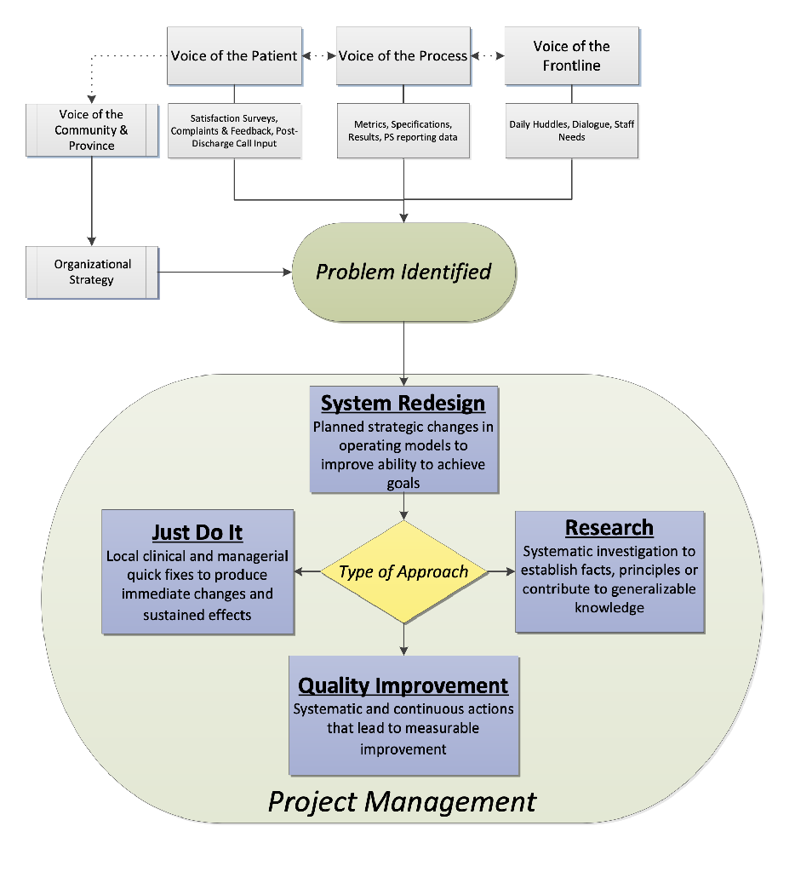
Where Does QI Fit In?
It is one of several approaches to solve problems
They all have unique pros/cons and these approaches complement each other
TOH Innovation Framework, Telfer Quality Improvement and Patient Safety Leadership Program, 2016-2017

Slide 15
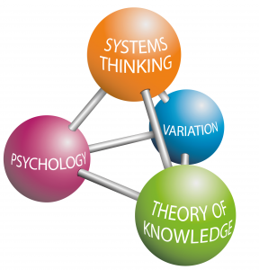
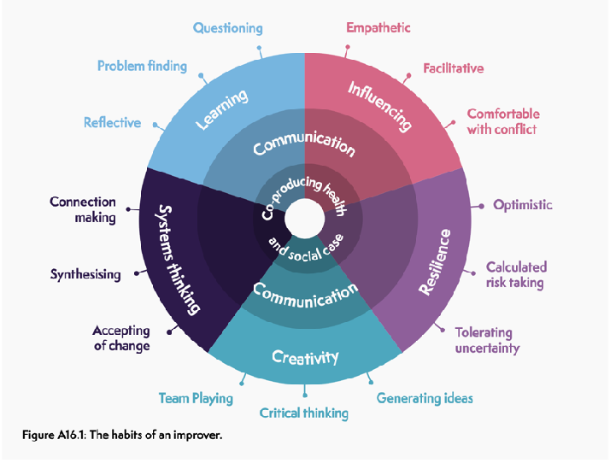
Quality Improvement
Blend of art and science
Complex and challenging
Few organizations/individuals do it well
Many QI initiatives FAIL to produce improvements in care
https://www.rcoa.ac.uk/safety-standards-quality/quality-improvement/raising-standards-rcoa-quality-improvement-compendium

Slide 16
Concept of Quality Improvement (QI)
Focuses on average performance (what happens most often)
Seeks to reduce unnecessary variation in care/outcomes
Goal to improve average common event (rather than eliminate rare incidents)
Thrives in learning environment with continuous data acquisition (CQI)
Involves multiple reiterative cycles (PDSA cycle)

Slide 17
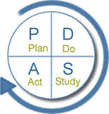
Plan a change, test or activity aimed at improvement
Develop a plan to carry out the cycle
Do the test and document observations
Analyze the data (first collect baseline data)
Act on the results: adopt the change, modify or abandon
What will be the next PDSA cycle? Or is it time to sustain the gains?
Study or Check the results
Complete the analysis of the data and compare to predictions
What was learned?
Langley, Nolan, Nolan Norman & Provost 1999

Slide 18
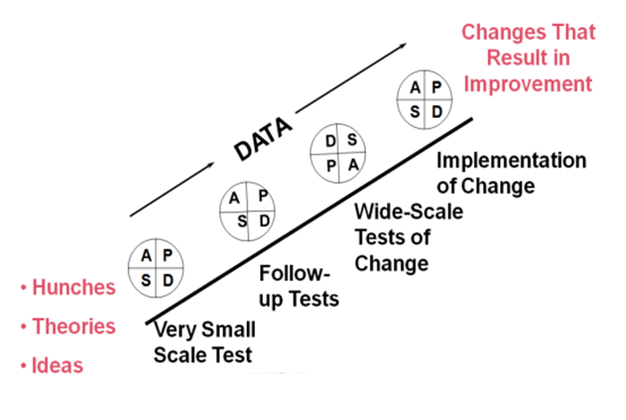
PDSA Ramp

Slide 19
Traditional Domains of Quality (STEEEP)
Safety: free from harm
Timeliness: minimizes wait time for care
Effectiveness: evidence based, achieves desired outcome
Efficiency: minimizes resource waste
Equity: accessible regardless of age/gender/ethnicity/SES
Patient Person-centeredness: individuals’ goals, wishes respected

Slide 20
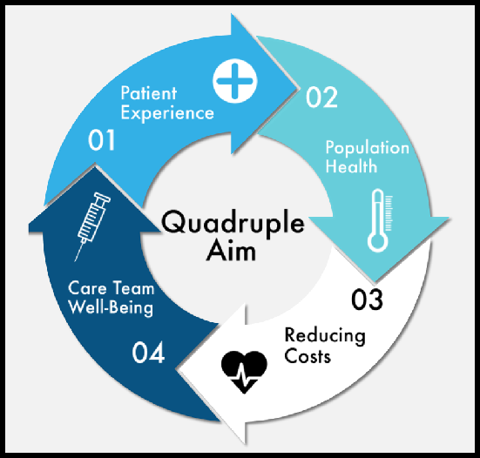
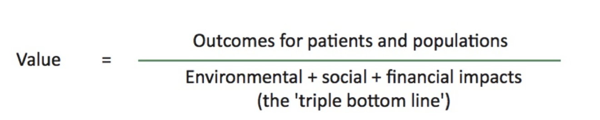
QI Evolution
Old equation: Value = Outcomes/Cost
Newer equation:
Includes wellbeing of healthcare staff
Includes societal/environmental costs
“Triple bottom line”:
Future Healthcare Journal, 2018 Vol.5(2):88-93
Ann Fam Med, 2014 Nov; 12(6): 573-576

Slide 21
Domains of Quality
Safety: free from harm
Timeliness: minimizes wait time for care
Effectiveness: evidence based, achieves desired outcome
Efficiency: minimizes resource waste
Equity: accessible regardless of age/gender/ethnicity/SES
Person-centeredness: individuals’ goals, wishes respected
Planetary health*: minimizes environmental impact
Healthcare worker wellness*: improves healthcare worker sustainability
*Lucie Filteau’s additions ;-)
Institute of Medicine (IOM). Crossing the Quality Chasm: A New Health System for the 21st Century. Washington, D.C: National Academy Press; 2001

Slide 22
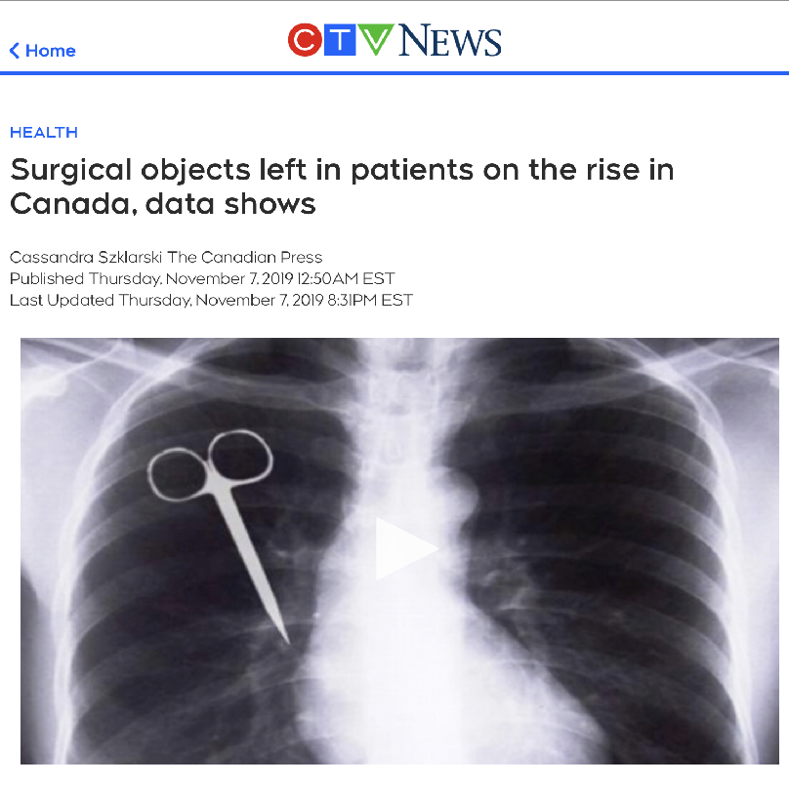
Safety
Avoiding harm to patients from the care that is intended to help them
Care should be free of accidents/mistakes
Avoiding harm to the healthcare team while providing care to patients*
*Lucie Filteau’s additions
Institute of Medicine (IOM). Crossing the Quality Chasm: A New Health System for the 21st Century. Washington, D.C: National Academy Press; 2001
Notes:
Consistent reversal of neuromuscular blockade
Freedom from medication errors
Temp mgmt

Slide 23
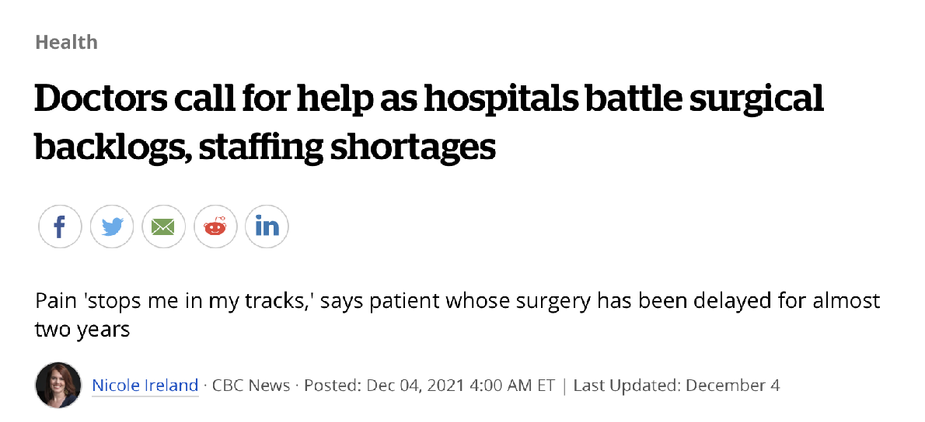
Timeliness
Reducing wait times and sometimes harmful delays for both those who receive and those who give care
Institute of Medicine (IOM). Crossing the Quality Chasm: A New Health System for the 21st Century. Washington, D.C: National Academy Press; 2001
Notes:
Wait time for epidural analgesia

Slide 24
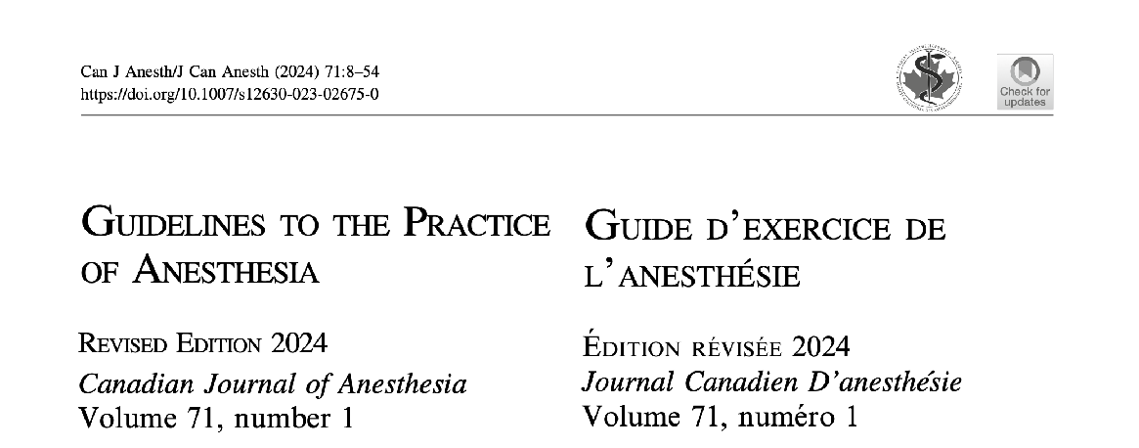
Effectiveness
Providing services, based on scientific knowledge, to all who would benefit and refraining from providing services to those not likely to benefit (avoiding underuse and misuse).
Care received should work and follow the existing Guidelines.
Institute of Medicine (IOM). Crossing the Quality Chasm: A New Health System for the 21st Century. Washington, D.C: National Academy Press; 2001
Notes:
Quality of postop analgesia
PONV prophylaxis

Slide 25

Efficiency
By streamlining and improving workflows, avoiding waste of resources, including
Equipment
Healthcare supplies
Information
Energy
Time
Money
*Lucie Filteau’s additions
Institute of Medicine (IOM). Crossing the Quality Chasm: A New Health System for the 21st Century. Washington, D.C: National Academy Press; 2001
Notes:
Time in PACU
Same day discharge

Slide 26

Equity
Providing care that does not vary in quality because of personal characteristics
Gender
Ethnicity
Geographic location
Socioeconomic status
Disability
Sexual orientation
Gender identity
*Lucie Filteau’s additions
Institute of Medicine (IOM). Crossing the Quality Chasm: A New Health System for the 21st Century. Washington, D.C: National Academy Press; 2001
Notes:
Access to epidurals for labour analgesia in Northern Communities
Access to an ICU bed when needed

Slide 27

Patient Person*-Centeredness
Providing care that is respectful of and responsive to individual patient preferences, needs and values and ensuring that patient values guide all clinical decisions
Consideration should also be given to respecting the needs and values of the healthcare workers
*Lucie Filteau’s additions
Institute of Medicine (IOM). Crossing the Quality Chasm: A New Health System for the 21st Century. Washington, D.C: National Academy Press; 2001
Notes:
Choice of anesthetic technique
Code status wishes obtained
Quality of patient periop experience
Access to APS follow up post discharge

Slide 28

Planetary Health*
Providing care that is mindful of and attempts to minimize the environmental impact
*Lucie Filteau’s additions

Slide 29

Provider Wellness*
Initiatives whose aim are to improve the health, wellness and sustainability of members of the healthcare team
*Lucie Filteau’s additions

Slide 30
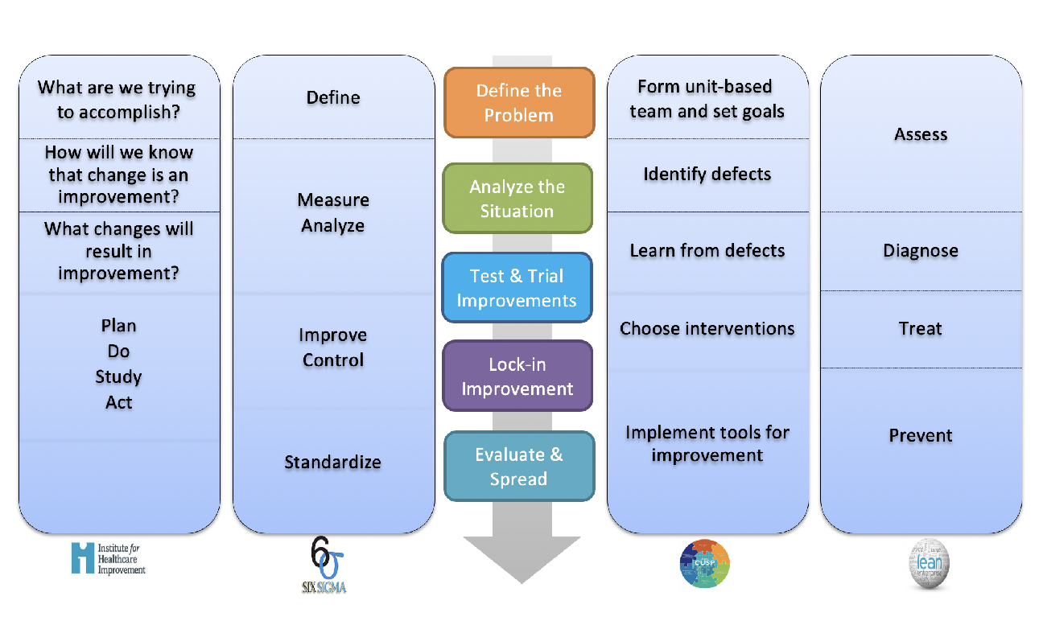

Various QI Frameworks
Pros/cons to each
Some made for industry
Some focus on streamlining/efficiency
Some jump into change too soon

Slide 31
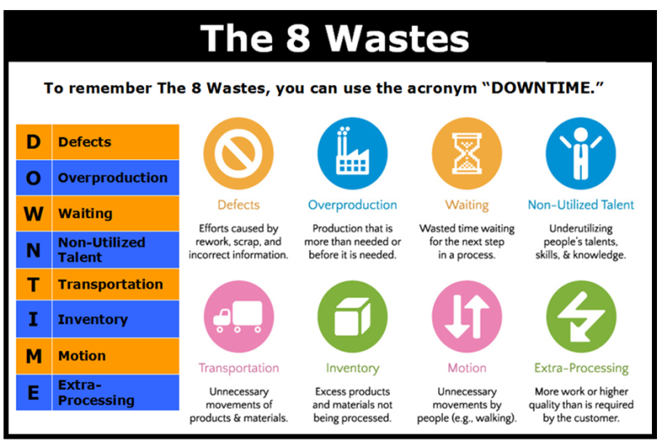
Lean 6 Sigma Framework:
A philosophy and specific set of tools to eliminate waste and improve flow
Origins in industry
One aspect of QI but doesn’t address all issues in healthcare
https://lean6sigma4all.eu/lean-management-and-the-8-wastes/

Slide 32

Examples of Waste in Healthcare
http://cdn.leanblog.org/wp-content/uploads/2013/03/8-types-of-waste-lean-hospitals.png

Slide 33
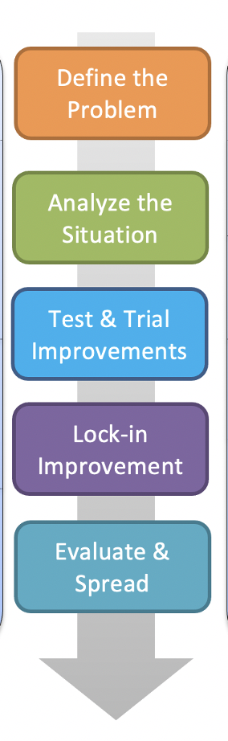
TOH Innovation FrameworkTM
Healthcare specific
Canadian!
Versatile
lends itself to many different types of QI projects (safety, efficiency, etc)
Scalable
tools can be used for smaller and larger, more complex projects
Detailed, step by step guide
Emphasis on full study of problem before planning change
Attention to work done at end of initiative

Slide 34
TOH Framework: QI Project Steps
Define the problem
Analyze the situation
Develop a plan for improvement
Test and trial improvements
Lock-in improvements
Evaluate and spread

Slide 35
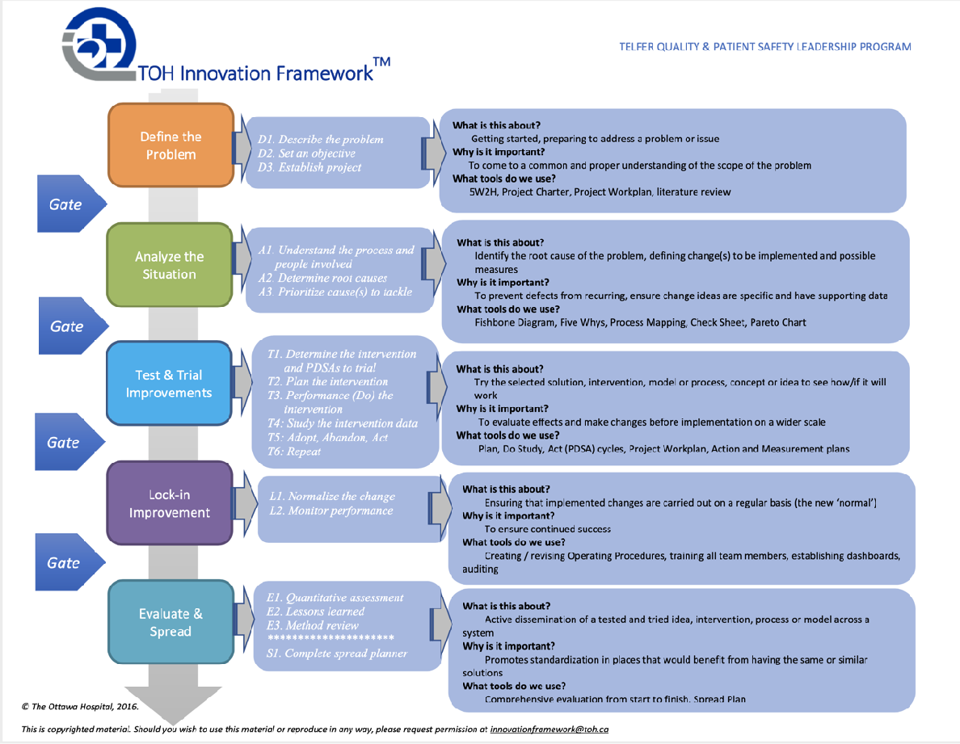
TOH Innovation FrameworkTM Details

Slide 36
Developing an Improvement Plan
Aim Statement (SMART)
Specific
Measurable
Attainable
Relevant
Time-framed
Identification of stakeholders, responsibilities
Identification of supports required
Communication, change management plan

Slide 37
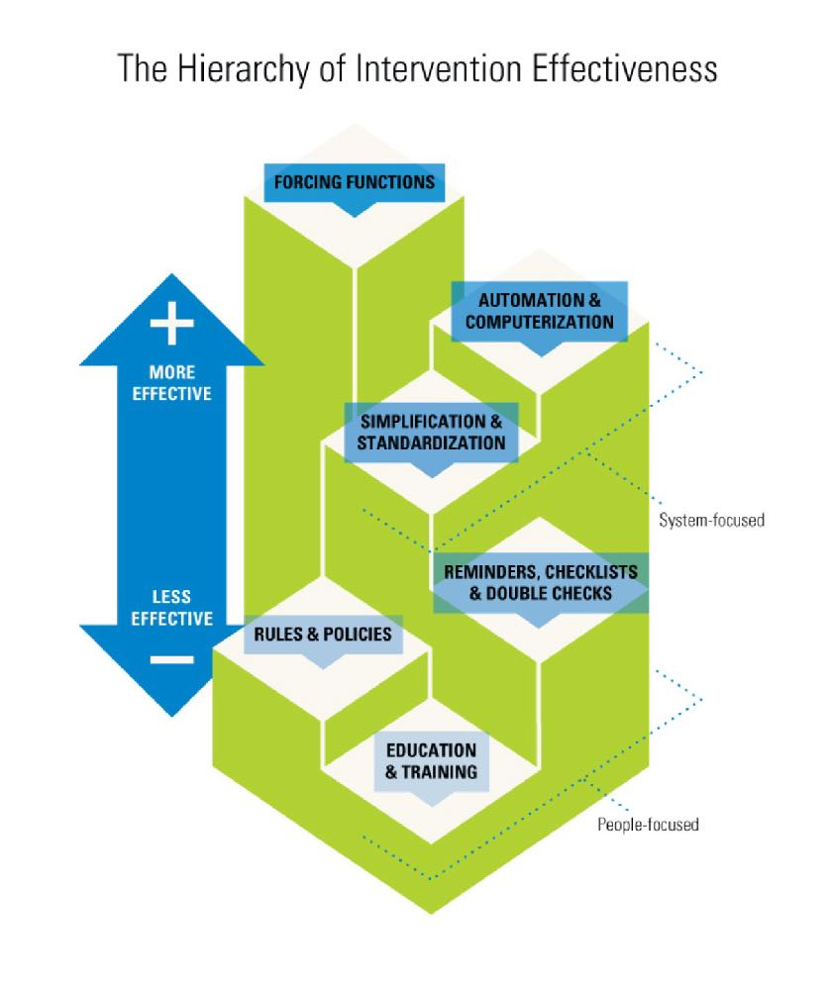
Hierarchy of Intervention Effectiveness
Forcing functions
- O2/N2O/Air hoses
Automation
- EPIC allergy warnings
Standardization
- Care maps
Checklists
- Surgical safety checklist
Policies
- Hospital PPE usage rules
Education/training
Diagram created by Cassie McDaniel

Slide 38

The Importance of Measurement
To determine if you truly have a problem
To determine the magnitude of the problem and where it’s occurring
To convince those in power to allot resources to the project
To convince the front line that change needs to happen
To monitor if the various iterations of your initiative made a difference
Not everything that counts can be counted and not everything that can be counted counts...
Albert Einstein

Slide 39
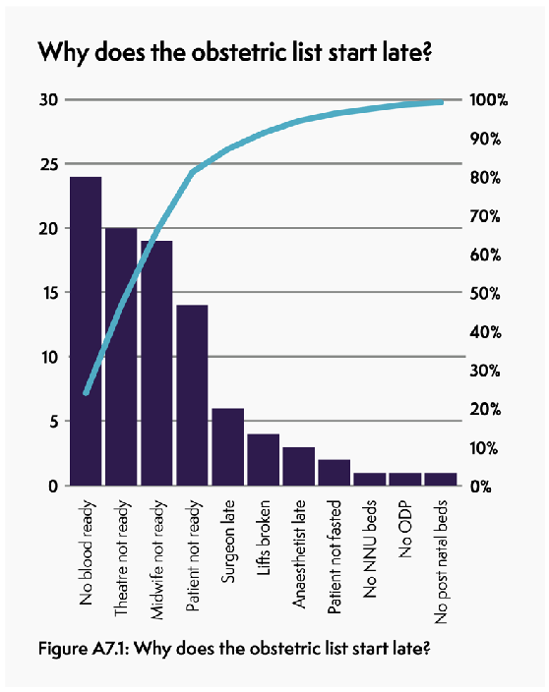
What to Measure?
Outcome measures
Directly related to the aim of the project
Reflects the measure of the performance of the whole system
Shows overall impact, not underlying activity
Process measures
Shows if planned interventions are being performed
Shows how an intended change is working in a specific setting
Is recommended practice carried out?
Balancing measures
Shows what else is happening to the system as a result of the change (unintended negative or positive consequences)
https://www.rcoa.ac.uk/safety-standards-quality/quality-improvement/raising-standards-rcoa-quality-improvement-compendium

Slide 40
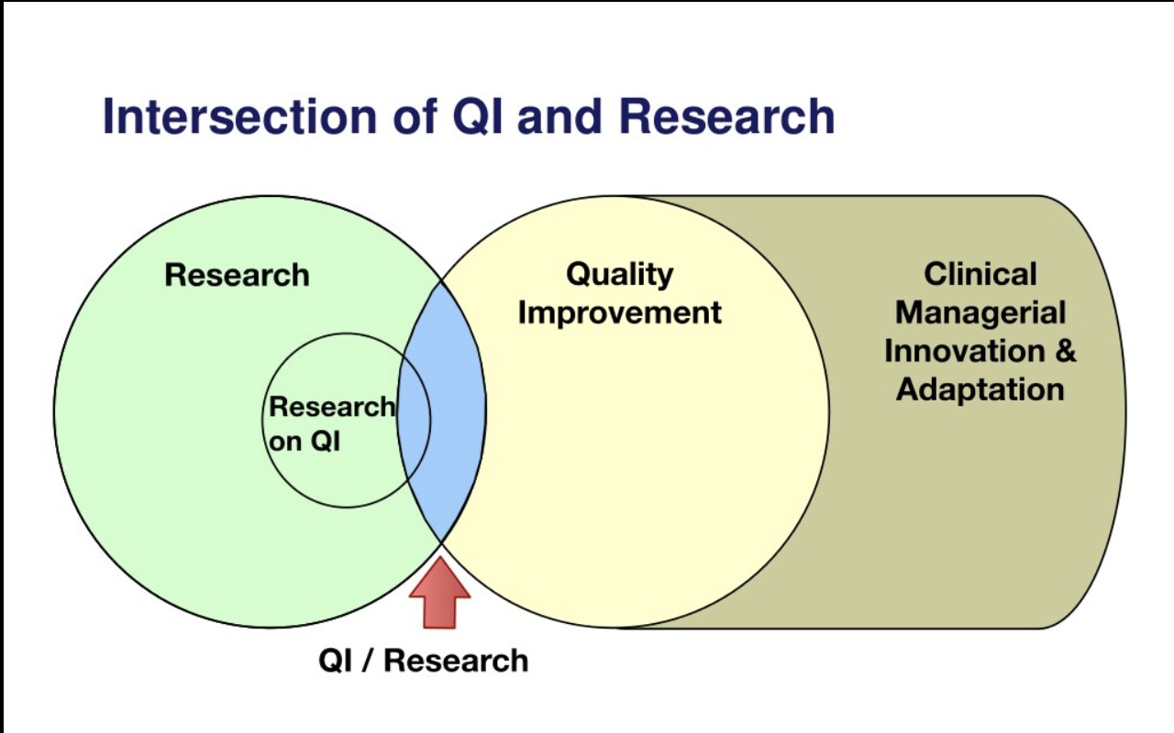
QI vs Research
The Hastings Center Report, July-Aug 2006

Slide 41
QI vs Research
Research
QI
Purpose: investigation to establish facts, contribute to knowledge base
Design: rigid protocol which remains unchanged
Mandate: not mandated by institution
Data: intends to answer a question, test hypothesis (independent of routine care)
Purpose: to implement knowledge to improve a process, program or system
Design: Adaptive, iterative design with PDSA cycles
Mandate: activities mandated by institution
Data: integral to ongoing management system for healthcare delivery
http://www.ohri.ca/ohsn-reb/forms/Checklist%20Research%20or%20QI%20-%20revised%20November%202%202016.pdf

Slide 42
QI vs Research
Research
QI
Analysis: prove/disprove hypothesis
Benefit: may or may not benefit current subjects, results not expected to immediately affect/change current practice
Risks: may put subjects at risk, consent required
Consent: required
Analysis: compare to established practice
Benefit: immediately/directly benefits a process and affect institutional practice (may benefit patients)
Risks: no direct risk to patients (except possible privacy breech)
Consent: not always needed
http://www.ohri.ca/ohsn-reb/forms/Checklist%20Research%20or%20QI%20-%20revised%20November%202%202016.pdf

Slide 43
QI vs Research
Research
QI
Adoption: dissemination of results take time, may or may not result in changes to care
Publication: presumed intent to publish at onset of project
Adoption: rapid dissemination of results occurs and changes adopted into local care delivery
Publication: intent to publish not presumed, although sharing of successes/insights encouraged
http://www.ohri.ca/ohsn-reb/forms/Checklist%20Research%20or%20QI%20-%20revised%20November%202%202016.pdf

Slide 44
The End!
(Images without reference from freepik.com)

Slide 45
This work is licensed under CC BY-NC-SA 4.0. To view a copy of this license, visit: https://creativecommons.org/licenses/by-nc-sa/4.0/

